Slide 1
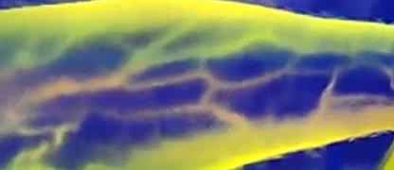
PrécisVeine
Improving the standards of care
Arslan Ahmed
Hafiz Usman Mahmood
Muhammad Talal Shahid
BEE-4
Advisor: Dr. Khawar Khurshid
Co-advisor: Dr. Awais Mahmood Kamboh

Slide 2
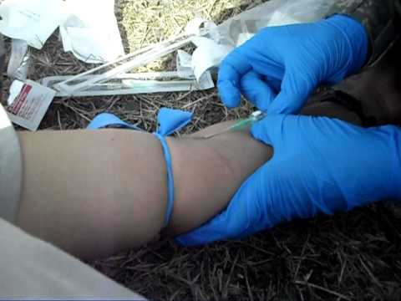
Problem Statement
Average attempts to find suitable vein: 2-3 times
- As per locally conducted survey
Complicated venipuncture and intravenous(IV) procedures
esp. obese, pediatric and dark skinned patients
Multiple punctures result in bruising, phlebitis or nerve injury
Patient’s distress and Decreased staff productivity

Slide 3
Literature review [1]
1) chemical paste on skin
Not suitable for children, doesn’t work on dark skin
2) ultrasound
expensive equipment, well trained staff
3) secondary light sources
Requires dark room, cause burns
4) Near Infrared Spectroscopy for Vein Visualization
- Vein Viewer, USA (bulky size) [2, 3]
- Accuvein, USA (ribbon needed) [4]
- Vasculuminator, Netherland (LCD is not user friendly) [5]

Slide 4
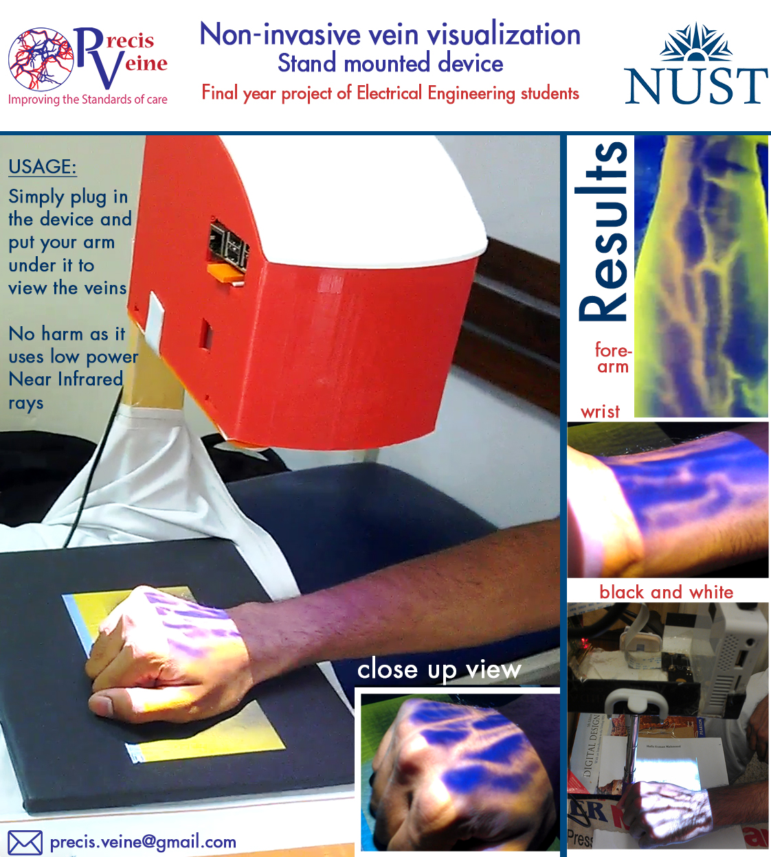
Our solution
Non-Invasive, stand mounted device
Small size and portable
Tolerant to movement of arm
Easy and Safe to use with no side effects
Works on all patient types regardless of age, size or skin tone
Cost effective, affordable for Pakistani market (around PKR 20,000 for bulk production)

Slide 5
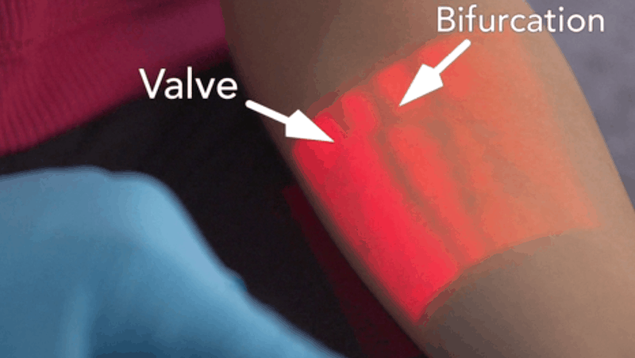
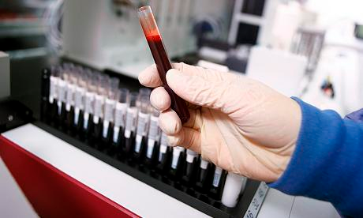
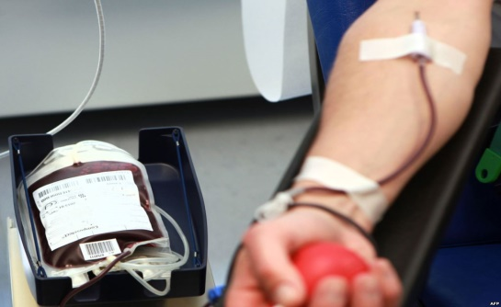
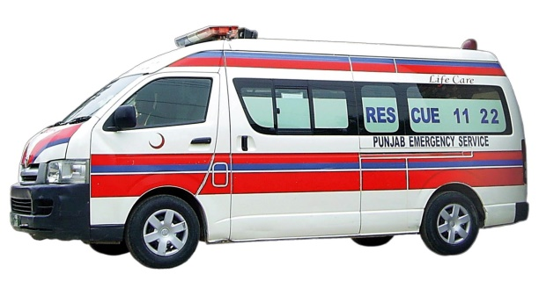
Potential Market [6]
Hospital Wards
(1300 govt. hospitals in Pakistan)
200+ IV procedures daily in each hospital
Blood Testing Labs
(4000 labs in Pakistan)
50+ samples are collected daily
Blood Banks
(2500 blood transfusion centers in Pakistan)
1.5m units of blood is transfused annually
Ambulances
Veins of emergency patients are constricted and difficult to find

Slide 7
Technical Discussion
Near Infrared Transmitter for arm illumination
Infrared Camera to capture the information
Image Processing in Raspberry Pi
Pocket Projector projects the image back on the arm
Region of interest

Slide 8
Main components:
Near Infrared source (850nm) [7]
Raspberry Pi 2 Model B
Raspberry Pi NoIR Camera
Pocket Projector
Main Algorithm: (CLAHE) Contrast Limited Adaptive Histogram Equalization [8]
Basic Principle:
Infrared rays can penetrate into the human tissues up to a depth of about 5 mm before scattering and deviating from the initial direction. [9]
The deoxy-hemoglobin present in venous blood absorbs the infrared light and the surrounding tissues reflect back the light.
The reflected light is captured using an infrared (night-vision) camera and processed in real-time.

Slide 9
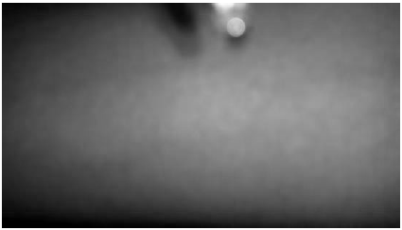
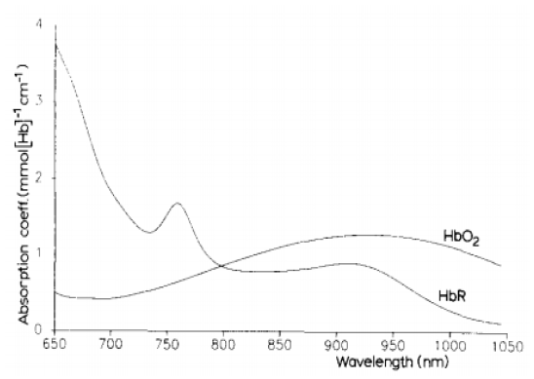
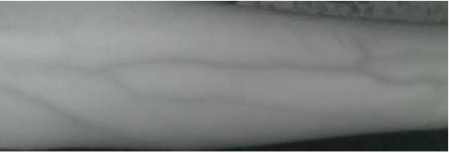
IR Absorption in Blood
Results at 940 nm
Results at 850 nm

Slide 10
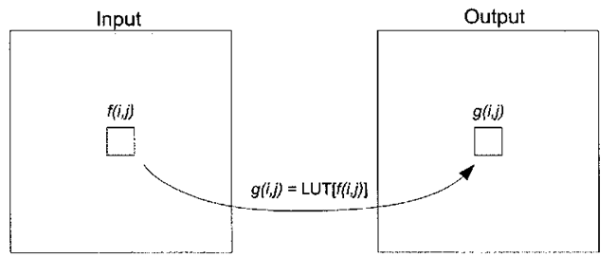
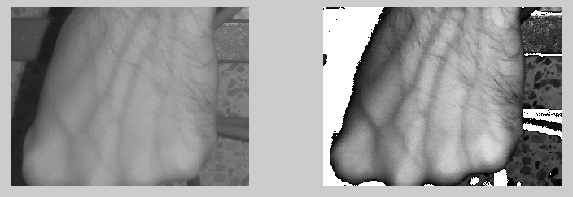
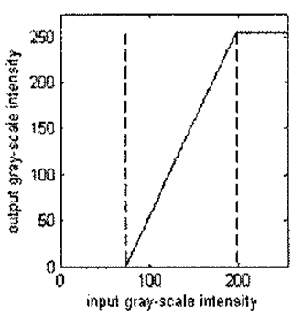
Window Level
those input pixels whose intensities lie within the range of interest are selectively contrast stretched.
Cropim(row,col)>=Lval && Cropim(row,col)<=Uval
Newim(row,col) = ((Cropim(row,col)-Lval)/(Uval-Lval));

Slide 11
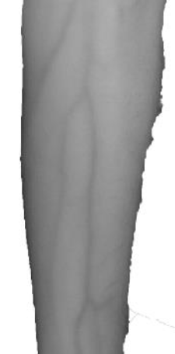
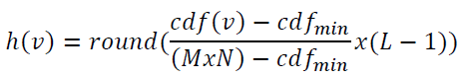
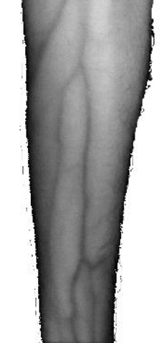
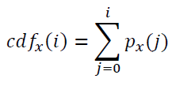
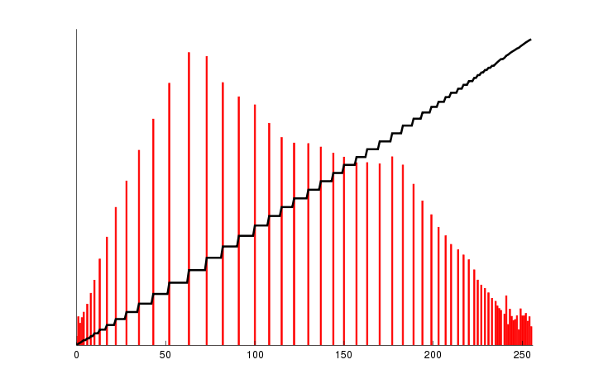
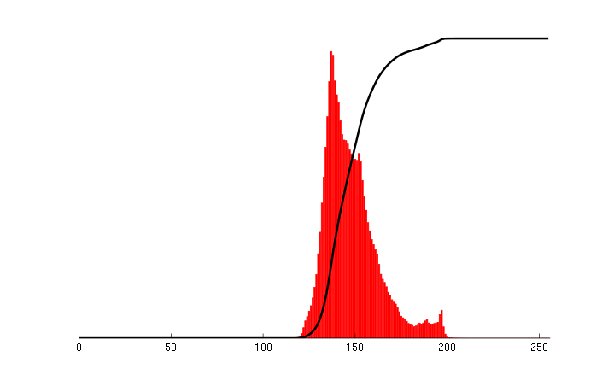
Histogram Equalization

Slide 12
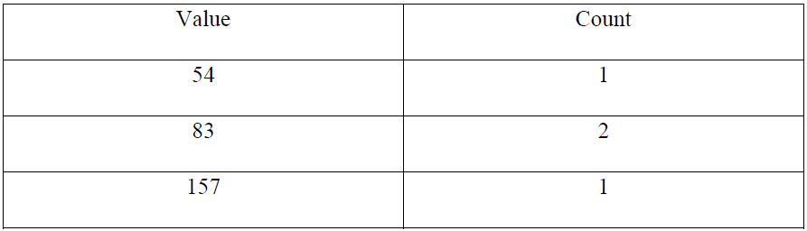
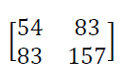
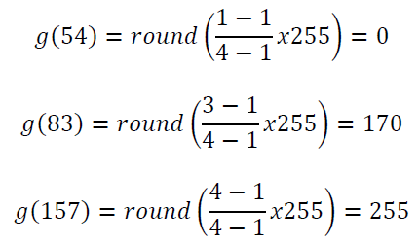
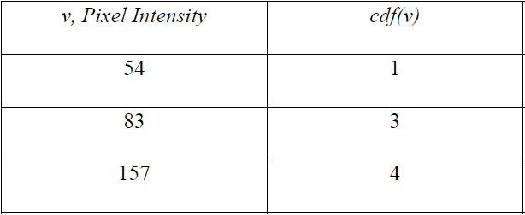
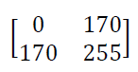
Example
Histogram in Tabular Form
Computing Cumulative Distribution Function
Application of General Histogram
Equalization Formula to each pixel
Equalized Image

Slide 13
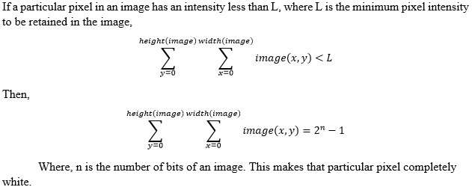
Background Subtraction

Slide 14
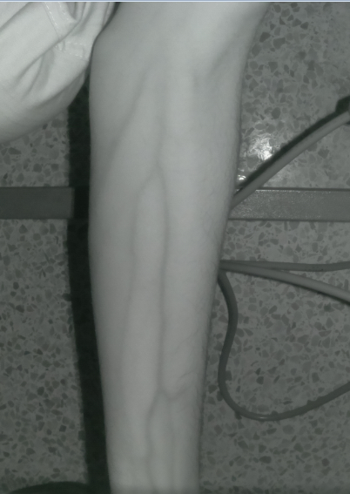
Cropping the ROI
OpenCV provides the functionality to crop a particular ROI using Numpy arrays.
i,new = i(x:x+a,y:y+b)
a = No. of pixels along x-direction from current pixel ‘x’
b = No. of pixels along y-direction from current pixel ‘y’
Image ‘i(x,y)’
Image ‘i,new(x,y)’

Slide 15
Power Ratings
Supply:
12V, 4A adapter
stepped down to 5V using buck converters
Consumption:
R pi + NoIR camera + LED: 5V, 2A
Pico Projector: charged at 5V, 2A
LEDs assembly: 12V, 1.2A
Cooling Fan: 12V, 0.15A

Slide 16
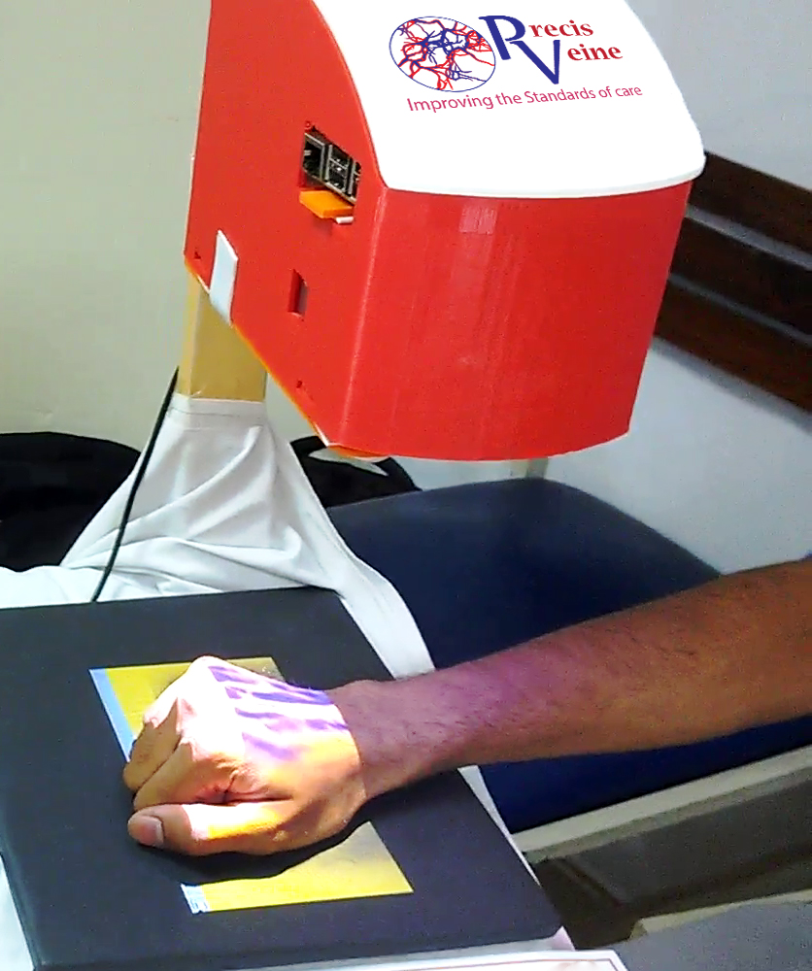
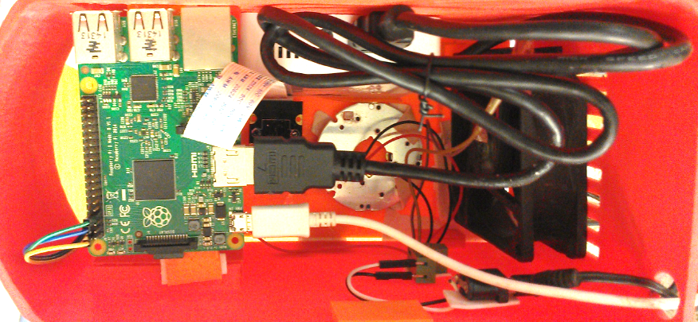
Prototype Design
Outside view
Inside view

Slide 17
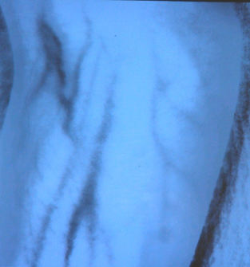
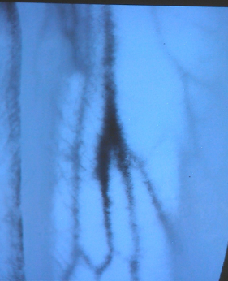
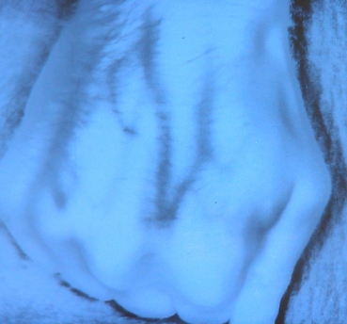
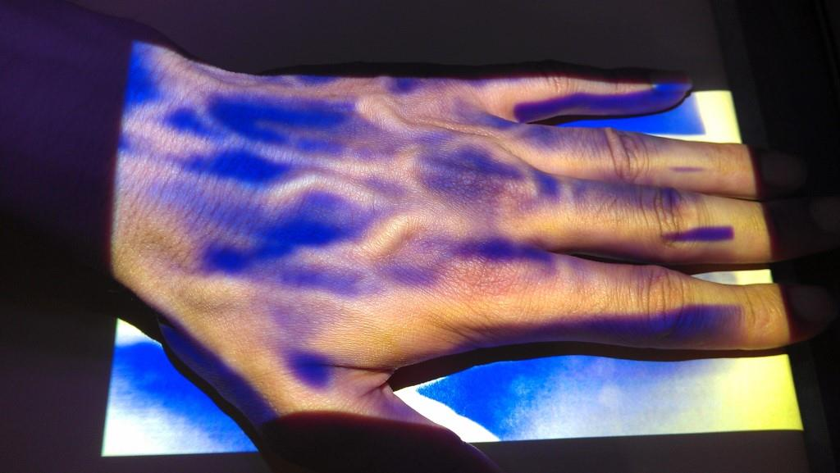
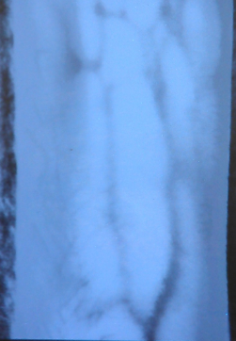
Results
Total = 78 samples | Clearly Visible | Mildly Visible | Not satisfactorily visible
Obese | 4 | 13 | 17
Non-obese | 26 | 15 | 3

Slide 18

Recognitions

Slide 19
Future Possibilities
This device can be further enhanced to determine very small diameter veins of:
septic shock patients
whose veins are contracted due to profused sweating
Moreover, infrared rays can also be used in fever screening, blood pressure monitoring, detection of gastrointestinal cancer and other similar IR based medical applications. Also for Blood alcohol concentration measurement and biometric hand recognition

Slide 20
References
[1] Juric, S., & Zalik, B. (2014). “An innovative approach to near-infrared spectroscopy using a standard mobile device and its clinical application in the real-time visualization of peripheral veins”. BMC medical informatics and decision making, 14(1), 1.
[2] Nundy, Koushik Kumar, and Shourjya Sanyal. "A low cost vein detection system using integrable mobile camera devices." India Conference (INDICON). 2010.
[3] AccuVein Website. URL: http://www.accuvein.com/.
[4] VeinViewer Vision Website. https://www.christiemed.com/. [accessed 2016-03-07]
[5] Cuper, N. J., de Graaff, J. C., Kalkman, C. J., & Verdaasdonk, R. M. (2010, February). “The VascuLuminator: effectiveness of a near-infrared vessel imaging system as a support in arterial puncture in children”. In BiOS (pp.75550U-75550U). International Society for Optics and Photonics.
[6] Pakistan Medical & Dental Council website. URL: http://www.pmdc.org.pk/Home/tabid/36/Default.aspx/
[7] Susan Wray; Mark Cope; David T. Delpy; John S. Wyatt; E. Osmund R. Reynolds, “Characterization of the near infrared absorption spectra of cytochrome aa₃ and haemoglobin for the non-invasive monitoring of cerebral oxygenation,” Biochimica et Biophysica Acta (BBA) – Bioenergetics, vol. 933, no. 1, pp. 184-192, 1988.
[8] Djerouni, A., Hamada, H., Loukil, A., & Berrached, N. (2014). “Dorsal Hand Vein Image ContrastEnhancement Techniques”.
[9] F. B. Chiao; F. Resta-Flarer; J. Lesser, J. Ng; A. Ganz; D. Pino-Luey; H. Bennett; C. Perkins Jr; B. Witek, “Vein visualization: patient characteristic factors and efficacy of a new infrared vein finder technology,” British Journal of Anaesthesia, vol. 110, no. 6, pp. 966-971, 2013

